Slide 1
Mis-measured Treatment Effects
Fall 2009
Bill Evans

Slide 2
Angrist and Evans
Impact of children on labor supply
Use sex composition of 1st 2 kids as instrument for whether parents have a third
  Moms w/ 2 boys or 2 girls more likely to have a third
In original paper, models were estimated by 2SLS

Slide 3
Outcomes
  Weeks worked
  Income
  Hours worked per week
Covariate of interest
  Morekids – Mom has more than 2 kids
  2SLS ignores the dichotomous nature of the variable

Slide 4
Can estimate as a mis-measured treatment effect model

Slide 5
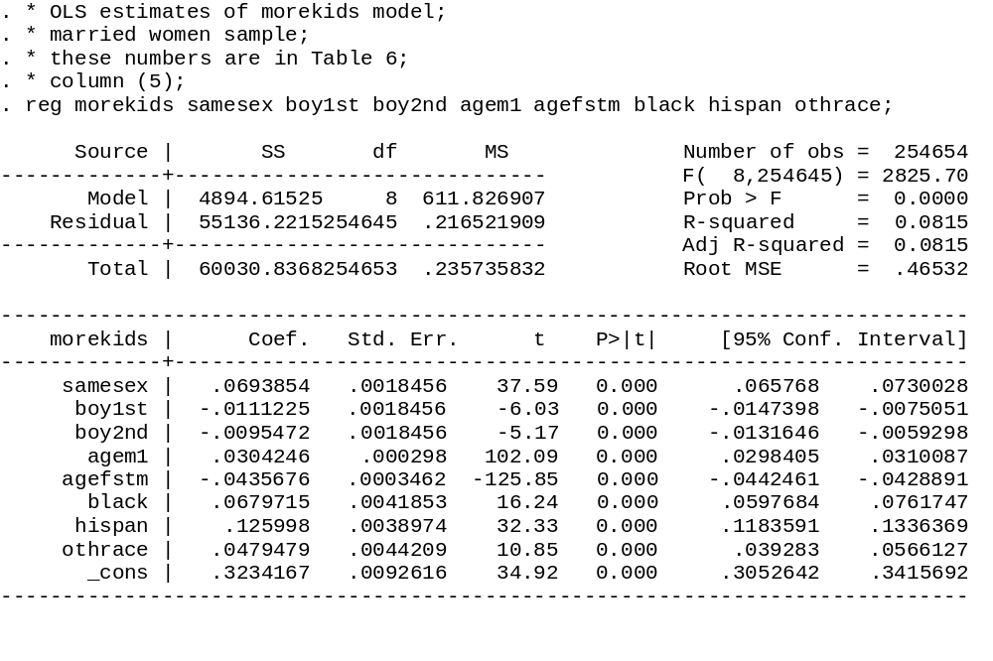
Remember 1st stage effect – roughly 7 percentage points

Slide 6
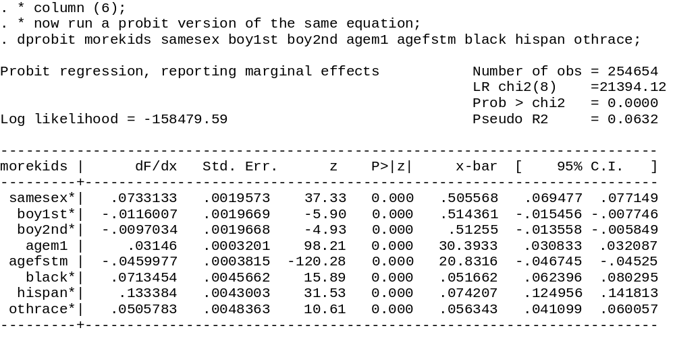
When you estimate as a probit, the marginal effect
Is slightly larger, at 7.33 percent (5.7% larger)

Slide 7
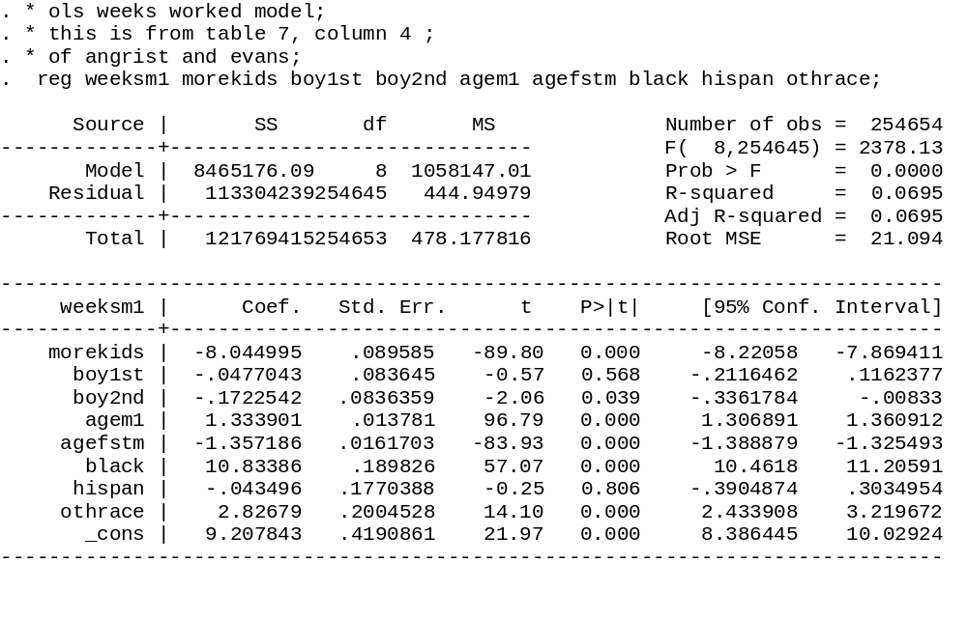
We suspect this model is inconsistent, but, the addition of a kid in the
Household reduces weeks worked by 8

Slide 8
* the mismeasured treatment effect model;
* the syntax is treatreg y x, treat(t=x z) where y is the outcome;
* x is the list of exogenous factors, t is the treatment variable;
* and z are the instruments;
treatreg weeksm1 boy1st boy2nd agem1 agefstm black hispan othrace,

Slide 9
. * the mismeasured treatment effect model;
. * the syntax is treatreg y x, treat(t=x z) where y is the outcome;
. * x is the list of exogenous factors, t is the treatment variable;
. * and z are the instruments;
. treatreg weeksm1 boy1st boy2nd agem1 agefstm black hispan othrace,
> treat(morekids=boy1st boy2nd agem1 agefstm black hispan othrace samesex);

Slide 10
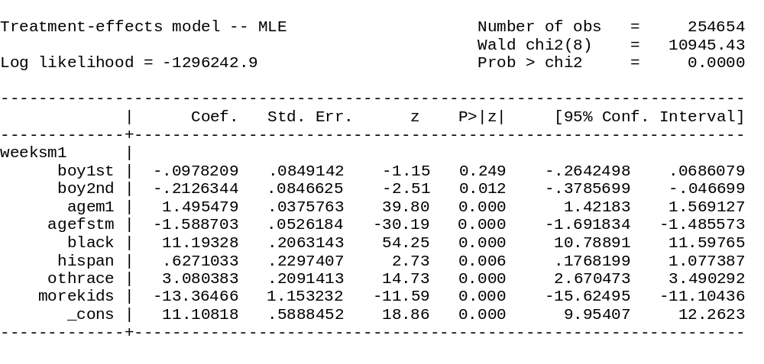
Structural equation of interest – Note the increase in the coef on Morekids

Slide 11
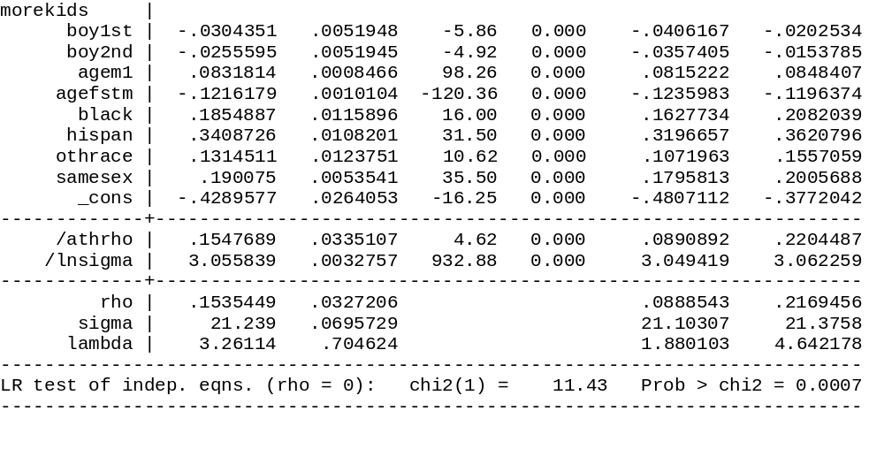
First stage – when this is estimated as a system, the effect of samesex on
More kids is now much larger at 19% points
Rho is estimated to be positive – those who work more are more likely
To have a third kid, that means the OLS estimate is biased up, but since
Coefficient on morekids in weeks model is negative, will make larger negative
number

Slide 12
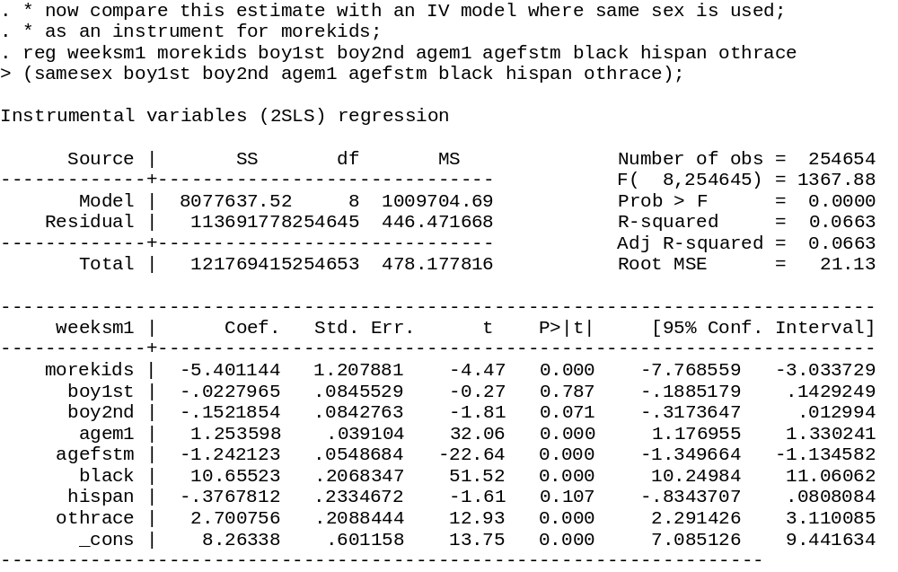
2SLS produces completely different answers

Slide 13
